Slide 1
VA Site Comparison for OCTO mtg
Health-things
VFS-APT Health Apartment | December 23, 2021
Notes:
Meg

Slide 2
VA.gov

Slide 3
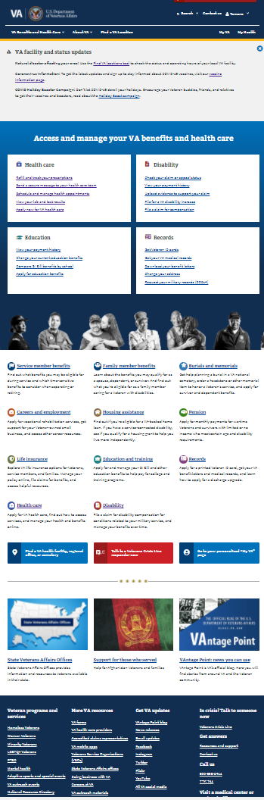
VA.gov
Top Banner
Top Banner:
Drop down navigation tabs w/ bucket content (no detail) for:
VA Benefits and Health Care
About VA
Find a VA Location
Action buttons:
MyVA
My Health (authenticated)
Search link / box
High Banner:
Reducible advertising space
Health-things premiere cards (action intent):
Health care
Refill and track prescriptions
Send a secure message to you healthcare team
schedule and manage health appointments
View lab and test results
Apply for VA care
Disability
Check you claim or appeal status
View your payment history
upload evidence to support your claim
File for a VA disability increase
File claim for compensation
Health-things lower level cards (information links):
Health care
Disability
Find a VA health facility, regional office, or cemetary
Talk to a Veterans Crisis Line responder now
Sign-in or create an account to use more tools
Low banner:
Advertising card space (3)
Bottom banner (Information page links):
Veteran programs and services (PTSD, Mental health, adaptive sports and special events)
More VA resources (VA Health providers [find a VA healthcare provider], VA mobile apps
In Crisis? Talk to someone (Veteran crisis line)
High Banner
Premiere
Lower level
Low banner
Bottom navigation

Slide 4
VA.gov
Redundancies:
There are several redundancies within the page for getting to where you need to go. Two premier links under disability are duplicative with same direct (File for a VA disability increase, File a claim for compensation)
Actions are not actions:
Although there are call to action buttons in the premier cards, the link is to another page (VA health care) where the client needs to sort through additional information to find the original action. Once found, the client is then taken to another site (MyHealtheVet) where the process repeats and the client is able to hit the action button that completes their action.
Hidden health-things (24):
- 19 are only located if you select an item from page and are navigated away to VA health care
- 5 are action items (Order prosthetic socks, Get medical records, Update health benefits info, Pay your VA copay bill, Get travel pay)
- 6 are found only in top navigation or if navigated away to VA health care page
Not working or misdirected links:
Premier cards
- View your lab and test results will take you to Rx refill
Top banner navigation
- Batteries and hearing aids drills down to link that takes you to Covid-19 vaccines at VA
Hidden buttons on sub-page
- Order Prosthetic socks drills down to link under construction

Slide 5
VA.gov
Unauthenticated experience:
MyVA in top banner directs you to single login. You cannot access MyVA without authenticated log-in
VA.gov subpage (VA health care) page suggests logging in, in order to execute action items
In items where login is not front loaded, clients are asked to log in to execute functions in linked pages.
Authenticated Experience:
Have access to link “MyVA” page, in Health-things lower level cards
Have ability to have “MyHealth” tab in top banner, that if selected takes client to their “MyHealtheVet” page
First Name in top banner
Have ability to navigate without multiple login requests

Slide 6
VA.gov/my-va/

Slide 7
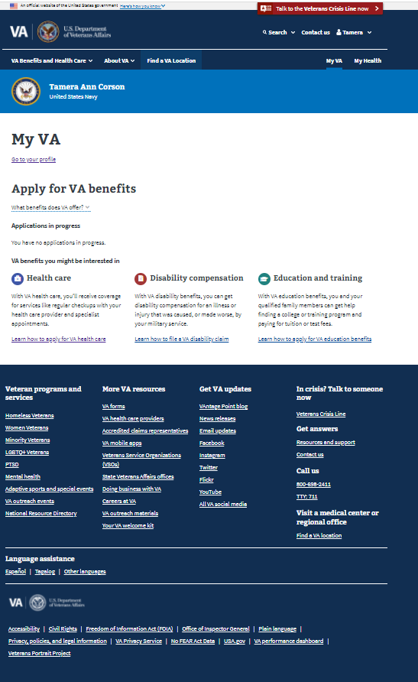
VA.go/my-va/ (Only an authenticated experience)
Top Banner:
Drop down navigation tabs w/ bucket content (no detail) for:
VA Benefits and Health Care
About VA
Find a VA Location
Action buttons:
MyVA
My Health
Search link / box
High Banner:
User identification
Health-things premiere cards):
Go to profile
Personal contact information
Military information
Direct deposit information
Notification settings
Account security
Connected apps
Send a secure message to you healthcare team
schedule and manage health appointments
View lab and test results
Apply for VA care
Apply for VA benefits
What benefits does VA offer
Application in progress (personalized)
Health-things lower level cards (information links):
Health care- Learn how to apply for VA benefits
Disability compensation- Learn how to file a VA disability claim
Health-things in bottom banner (Information page links):
Veteran programs and services (PTSD, Mental health, adaptive sports and special events)
More VA resources (VA Health providers [find a VA healthcare provider], VA mobile apps
In Crisis? Talk to someone (Veteran crisis line)
Top Banner
High Banner
Premiere
Lower level
Bottom navigation

Slide 8
VA.go/my-va/ (Only an authenticated experience)
Redundancies:
My-VA is redundant with VA.gov, specifically sharing same top tab navigation and bottom navigation. Additionally, the lower level cards are identical in feel and appearance, although limited in function. A user could have had the same, if not better, experience as an unauthenticated VA.gov user, save for the personalized banner, ability to enter direct deposit information, and quick access to MyHealtheVet via My Health in top banner.
Unique content:
- Manage profile information
- Look at a list of connected apps [connected to MyVA-8]
Hidden health-things (1):
- Connected Apps
- Other hidden content is commonly looked for under profile in many government and commercial web presence

Slide 9
MyHealtheVet

Slide 10
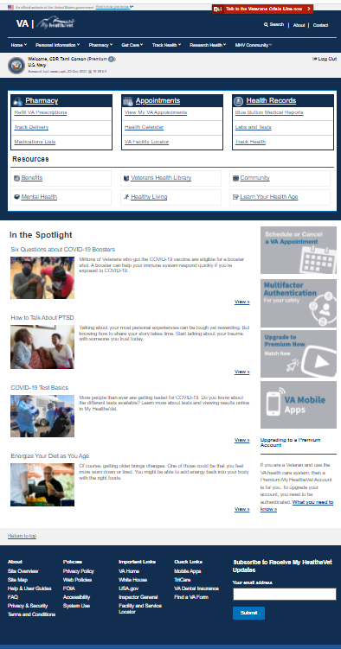
MyHealtheVet
Top Banner
Top Banner:
Drop down navigation tabs w/ bucket content (no detail) for:
Home
Personal information
Pharmacy
Get Care
Track health
Research health
MHV Community
Search link / box
High Banner:
User identification & last accessed (authenticated)
Call out to log in (unauthenticated)
Health-things premiere cards):
Pharmacy
Refill VA prescriptions (authenticated)
Track delivery (authenticated)
Medication lists (authenticated)
Appointments
View my VA Appointments (authenticated)
Health calendar (authenticated)
VA Facility Locator (authenticated)
Health records
Blue Button Medical Reports (authenticated)
Lab and tests (authenticated)
Track health (authenticated)
Messages (Cannot access???)
Health-things lower level cards (information links):
Benefits
Mental health
Veterans health library
Healthy living
Community
Learn your health age
Low banner:
Spotlight articles
Upgrade to premium account
Multi Factor authentication
Schedule or cancel VA appointment
VA Mobile Apps
Health-things in bottom banner (Information page links):
VA dental insurance
Tricare
Subscribe to MHV updates
High Banner
Premiere
Lower level
Low banner
Bottom navigation

Slide 11
MyHealtheVet
Redundancies:
“View my VA appointments” in Premiere card takes user to same place as “Schedule” or “Cancel VA appointment” in the low banner area.
Unique content:
- Mental Health resources, education, tools
- Veterans health library (education articles on disease, wellness, studies, horizon)
- Healthy living content (eat, physical, sleep, medication)
- Community (subscribe to MyHealtheVet newsletter, VA mobile apps-22)
- Healthy living assessment (pull medical record and self disclosed data with healthy living assessment to generate report)
- Rx refill mobile app
Poor loop:
Benefits loops you back to VA.gov homepage
Hidden health-things (1):
No hidden content that would not be easily found by MHV choices in buckets.

Slide 12
Health-things

Slide 13
Synthesis
Content analysis
Completed cross site content analysis of main and subpages on VA.gov, MyVA, MHV
Cross-over:
-There is very little crossover between MyVA and MHV (profile and facility locator). The major area of crossover occurs because MyVA shares VA.gov header / footer navigation.
- MHV is more action focused and where educative, it pulls in information from VA.gov
-VA.gov is more robust in education, veteran direction, and things to be seen in unauthenticated mode
Unique content:
- Unique content exists mainly between VA.gov and MHV
Missing Content:
-information on Telehealth (presumably in VAOS) although educational content should be available in unauthenticated modes

Slide 14
OCTO Meeting

Slide 15
OCTO Meeting
Successes:
- Selection of premier cards for Health Apartment POC align with MHV and current research on GitHub
- Sketch allows VFS-APT team to keep relative form / feel of VA.gov
Concerns:
- Large chunk of health-things education and content exists on VA.gov pages
- Other linked information exists in other sites not controlled by VFS-APT team
- Other CEDAR teams are moving certain content; potential no-go zones
- No concrete sitemap for POC has been determined amongst stakeholders
- Testing is limited when veterans are not exposed to full gamut of health-things
Goal of OCTO meeting:
- Identify health-things or general content being built by other teams
- Identify health-things content intended for VFS-APT
- For content not being considered for VFS-APT or other teams, where will it be homed
- Meet team PM’s and PO’s working on crossing content

